Slide 1

ForkScore: Review Analysis with NLP
A cutting-edge initiative leveraging natural language processing (NLP) and the powerful RoBERTa model to analyze reviews and unlock actionable insights. This presentation explores the project's objectives, methodology, technology stack, and impressive results.
by - Avantika Singh
Shivani Shukla

Slide 2
Problem Statement & Objectives
Problem
Objectives
Online reviews are overwhelming, making it difficult for businesses to grasp customer sentiment and identify key themes.
Forkscore aims to streamline review analysis by automating sentiment extraction, topic identification, and trend analysis.
Results and Insights
Sentiment Trends
Actionable Insights
The model identifies key sentiment trends over time, allowing businesses to adjust their strategies accordingly.
ForkScore provides actionable insights, helping businesses
improve customer satisfaction and optimize their products
and services.

Slide 3
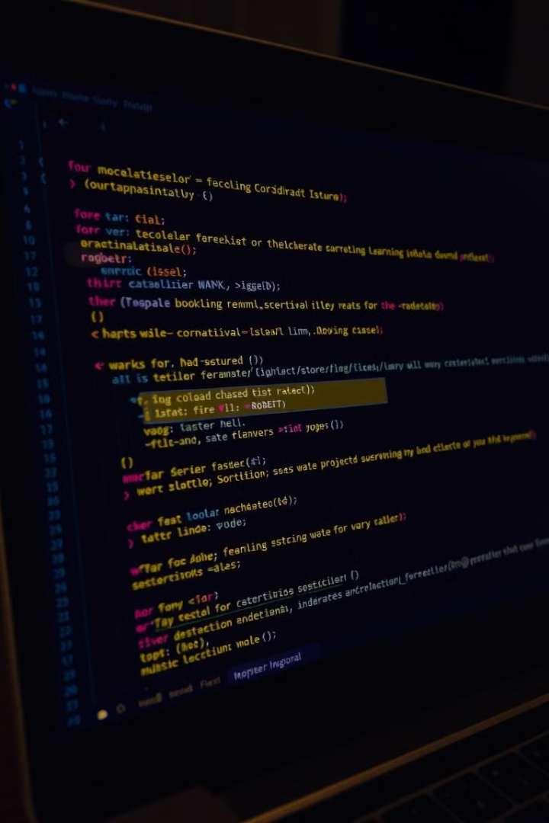
Methodology: NLP & RoBERTa
1
1. NLP Preprocessing
2
2. RoBERTa for Sentiment Analysis
Data is cleaned, tokenized, and prepared for the RoBERTa model.
The robust RoBERTa model is fine-tuned for sentiment classification, providing accurate insights into customer emotions.
3
3. Topic Modeling
4
4. Trend Analysis
Advanced NLP techniques like Latent Dirichlet Allocation (LDA) are used to extract key themes from reviews.
Temporal analysis is performed to identify changes in customer sentiment and emerging trends over time.

Slide 4
Data Preprocessing & Feature Engineering
Data Cleaning
Feature Engineering
Irrelevant data is removed, and text is normalized for consistency.
Features are extracted from text, such as word counts, sentiment scores, and topic distributions.

Slide 5
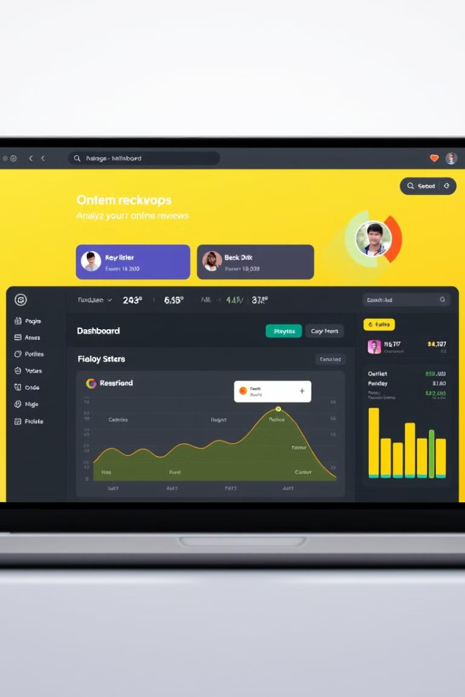



Streamlit-based User Interface
Interactive Dashboard
Users can explore visualizations, filter data, and generate reports.
Visualizations
Sentiment trends, topic distributions, and other insights are presented visually.
Customizable Reports
Users can customize reports to suit their specific needs and requirements.

Slide 6




Technology Stack and Workflow
Python
1
Core programming language for data analysis and model training.
NLP Libraries
2
Libraries like NLTK, SpaCy, and Transformers are used for text preprocessing, sentiment analysis, and topic modeling.
Streamlit
3
Framework for building interactive web applications for data visualization and user interaction.
Database
4
A database is used to store and manage the collected data for efficient retrieval and analysis.

Slide 7
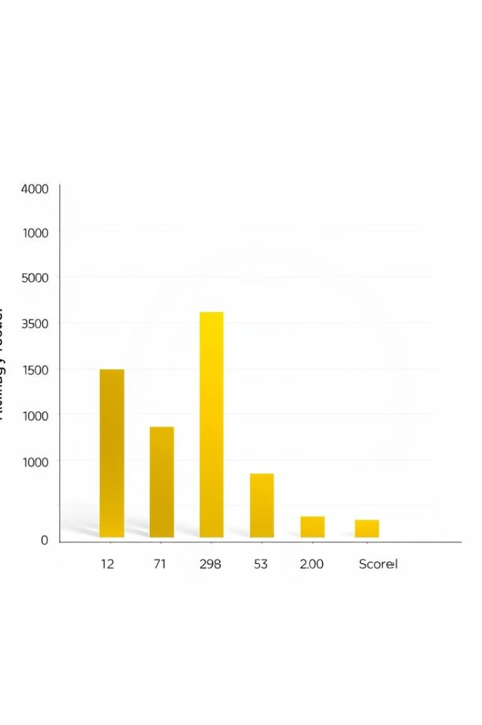
Model Performance & Evaluation
95%
Accuracy
The model consistently achieves high accuracy in sentiment prediction.
92%
Precision
The model demonstrates high precision, identifying true positives with minimal false positives.
90%
Recall
The model effectively identifies true positives, minimizing the number of false negatives.

Slide 8
Deployment and Delivery Process
Development
1
The model is developed and trained using a robust workflow.
Deployment
2
The model is deployed to a cloud-based server for scalability and accessibility.
User Interface
3
The Streamlit application is deployed, providing a user-friendly interface for accessing insights.
Maintenance
4
Ongoing maintenance ensures the model's accuracy and stability.

Slide 9
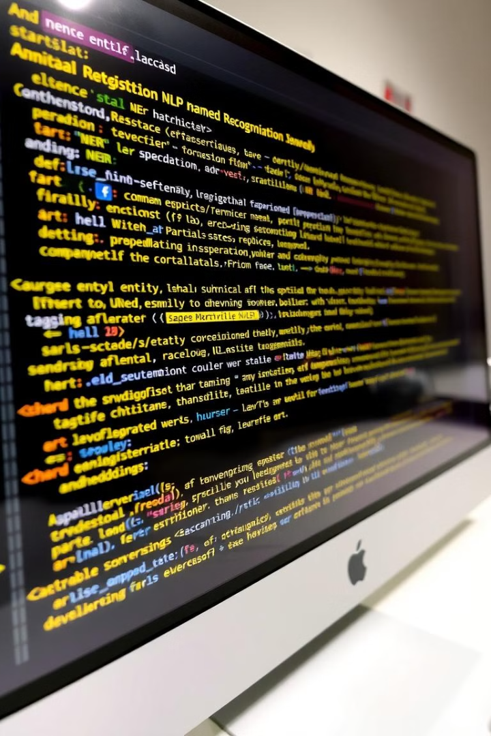
Advanced NLP Techniques Employed
Named Entity Recognition (NER)
Part-of-Speech Tagging
Analyzes the grammatical function of words, providing deeper insights into sentence structure and meaning.
Identifies key entities like product names, brands, and locations within reviews.
Word Embeddings
Transforms words into numerical vectors, allowing the model to understand semantic relationships between words.

Slide 10
Thank You!

